Slide 1

Predicting a Movie's Success Before Release
Briana Liu
Kanwal Iftikhar
Stephanie Gutierrez
Zach Blackburn

Slide 2
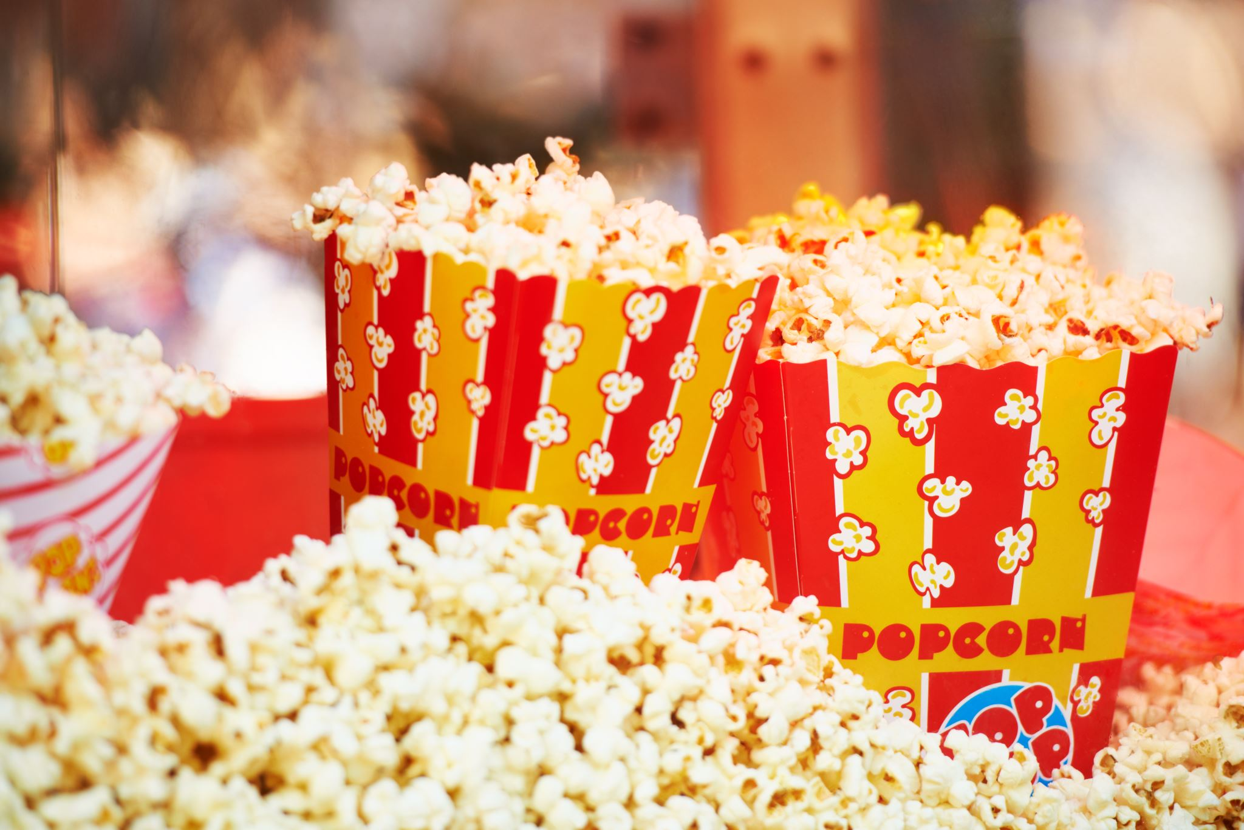
Overview:
Movies wield significant influence in modern culture, molding the realms of entertainment and lifestyle.
Individuals frequently allocate their leisure hours to indulging in movies or organizing trips to cinemas.
Despite high anticipation, many movies can disappoint in terms of content, leading to a sense of wasted time and money.

Slide 3

Goal
Be able to predict whether a movie will be successful depending on its:
Budget,
Runtime,
Popularity

Slide 4
Dataset
The Kaggle dataset uses information from TMDB due to copyright concerns from the IMDB website.
This dataset contains two data sources: tmdb_5000_credits and tmdb_5000_movies.
tmdb_5000_credits features:
movie_id, title, cast, crew
tmdb_5000_movies features:
budget, genres, homepage, id, keywords, original_language, original_title, overview, popularity, production_companies, production_countries, release_date, revenue, runtime, spoken_languages, status, tagline, title, vote_average, vote_count

Slide 5
Methodology
Data Acquisition
Obtain the TMDB 5000 Movie Dataset from Kaggle.
Data Preprocessing & Cleaning
Handle missing values, duplicates, and irrelevant features
Exploratory Data Analysis
Perform exploratory analysis to understand the distribution of features and their relationships.
Create visualizations to present findings and insights.
Visualization & Reporting
Train each selected model on the training data.
Model Training & Evaluation
Model Selection & Preparation
Feature Selection
Visualize key insights through graphs and plots.
Generate a correlation matrix to identify significant feature correlations.
Select relevant features to include in the predictive model.
Identify features that have a strong correlation with movie success metrics.
Choose suitable supervised learning models for prediction (Decision Tree, Random Forest, K-nearest Neighbors, SVM).

Slide 6

Libraries
# Importing all necessary libraries
import json
import numpy as np # linear algebra
import pandas as pd # data processing, CSV file I/O (e.g. pd.read_csv)
import matplotlib.pyplot as plt # this is used for the plot the graph
from numpy import median
import matplotlib.pyplot as plt
import warnings
import seaborn as sns
from pylab import rcParams
import matplotlib
from collections import Counter
from sklearn import metrics
from sklearn.model_selection import cross_val_score
from sklearn.metrics import confusion_matrix
from sklearn.ensemble import RandomForestClassifier
from io import StringIO
from sklearn.tree import export_graphviz
from IPython.display import Image
from sklearn.tree import export_graphviz
import pydotplus# Export as dot file
from sklearn.neighbors import KNeighborsClassifier
from sklearn import svm

Slide 7
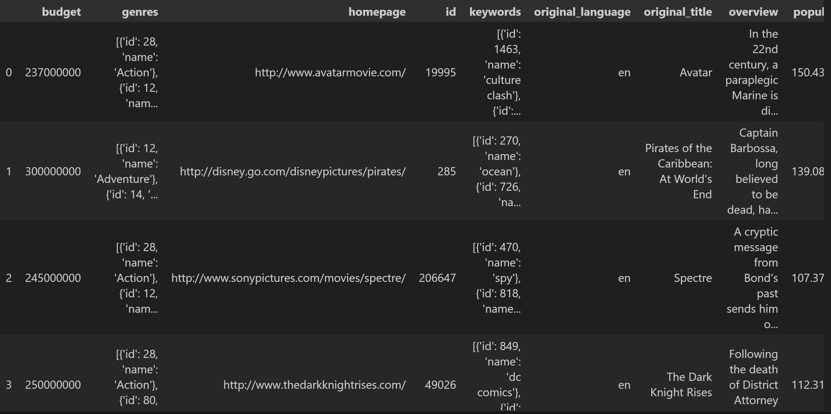
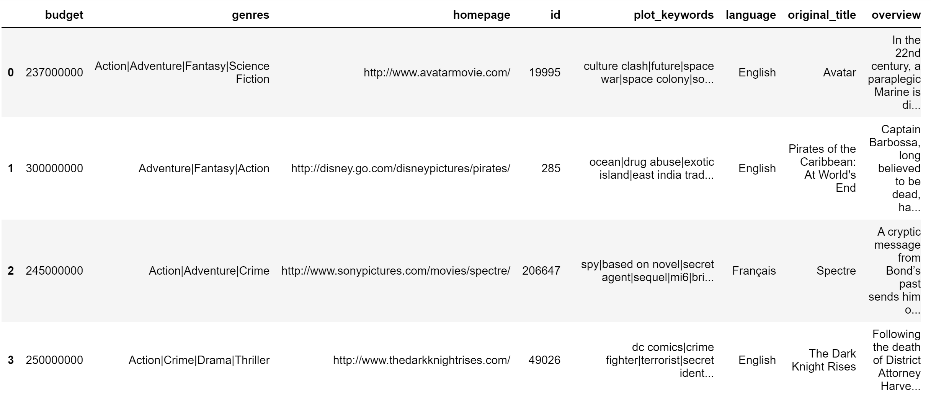
Data Preprocessing Before and After

Slide 8
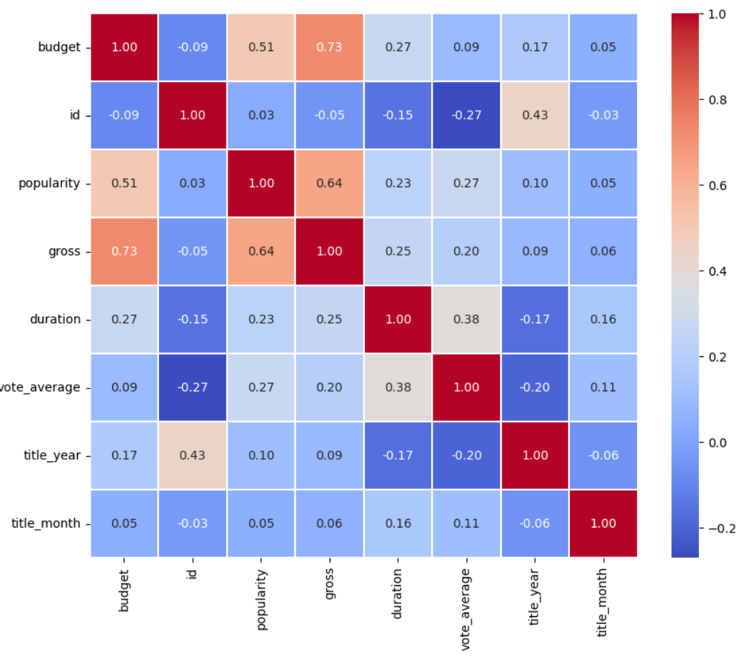
Correlation with Numerical values Heatmap
Correlation heatmap pre-data cleaning.

Slide 9
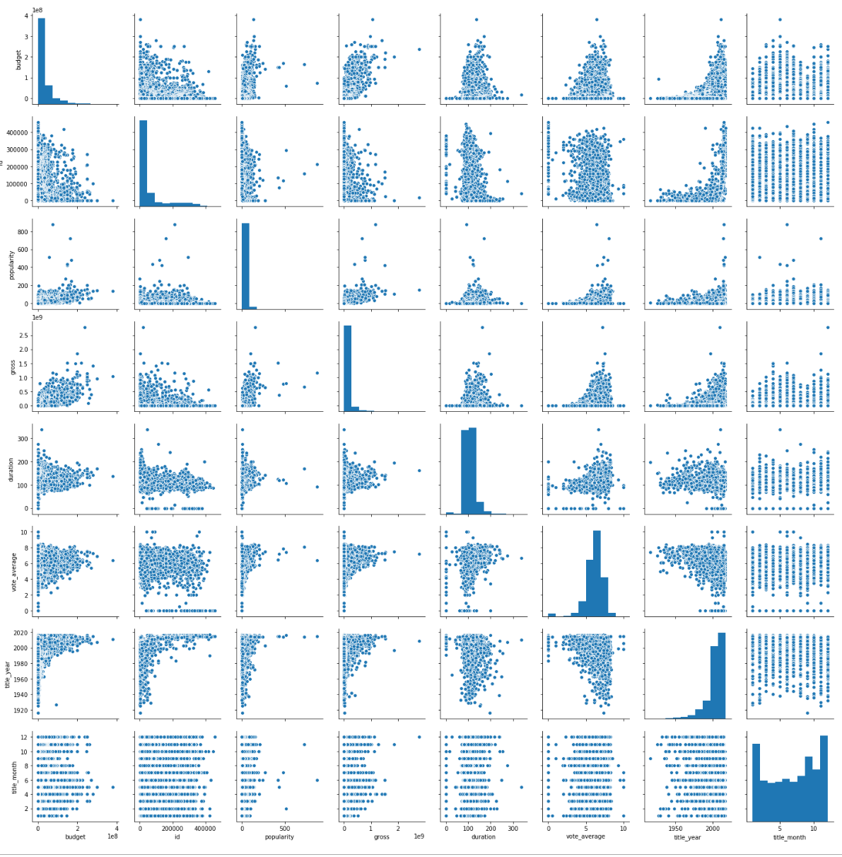
Correlation with Numerical values: Visualization Seaborn Library: sns.pairplot()

Slide 10
Success Criteria
Runtime: Runtime bins created to:
Less than 90min
90-120 min
120-150 min
150 min or more
Budget: Created budget bins:
Low
Average
High
Very high
Blockbuster
Popularity: Popularity was further divided into 3 columns:
'Popularity Success': if a movie's popularity feature is greater than the mean of all popularity scores.
'Vote Success': likewise if the voting_average of a movie is higher than the mean of all vote averages.
'Commercial Success': if a movie's gross profit exceeds its budget.

Slide 12

Supervised Learning Models
Decision Tree
Random Forest
K-nearest Neighbors
Support Vector Machine (SVM)
XGBoost

Slide 13
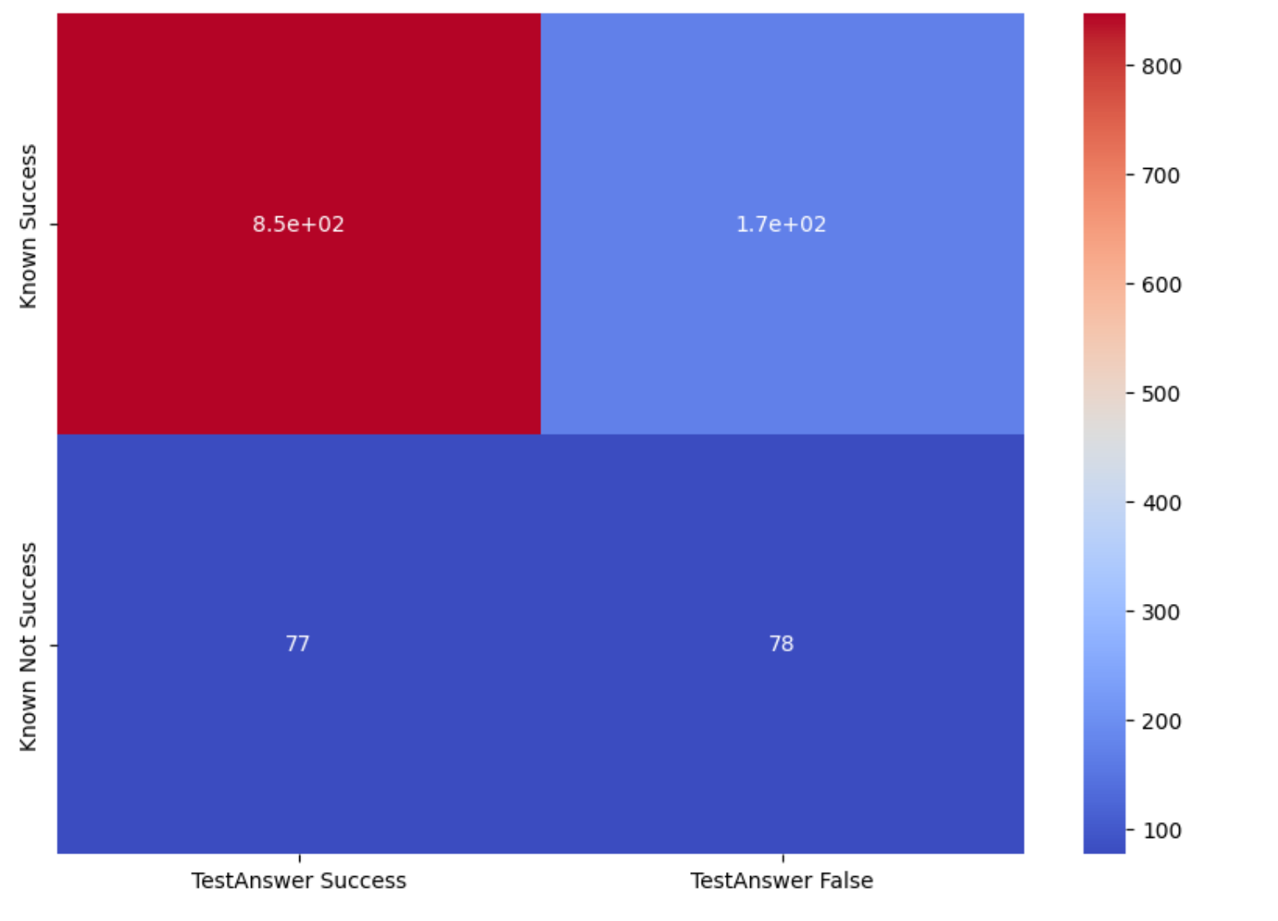
Decision Tree
To train our models, we split our data randomly so that 75% is used as training and 25% as predictions.
- Cross-validation accuracy: 73%
- Overall accuracy: 80%

Slide 14
Random Forest

Slide 15
K-nearest Neighbors

Slide 16
Support Vector Machine (SVM)

Slide 17
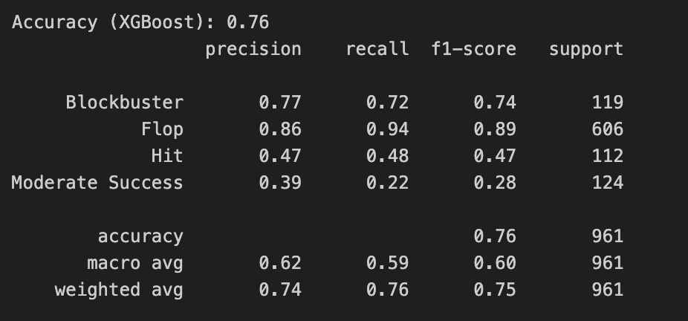
XGBoost

